Slide 1
Berkeley DB
By Shelby Hendrickx & Lucas van der Laan

Slide 2
Introduction
Data Model
Principles of Berkeley DB
Economics
Demo
Notes:
Datamodel behind berkeleydb
What berkeleydb is all about
The current economics of berkeley d
And finally a demo

Slide 3
Data Model
Key-Value Store
Pros:
Simplistic
Flexible
Scalable
Performance
Cons:
No support for complicated searches
Not OOP
Lack of standardization (e.g. no standards for keys)
Notes:
What is key value ?
Simple queries because one on one mapping,
Flex -> can be any key and any value
Scal -> supports huge data
Perf -> no overhead like in relat. Db
Lack of stadnard -> next slide

Slide 4
Data Model
Key-Value Store
Key | Value
John | johndoe@hotmail.com
Mammals | Bear, Cat, Dog, Elk, Fox
12984 | { first: “John”, last: “Doe”, age: “5” }
K1 | AAA, 2, 01/01/2015
0x352CDF3F | Img://cat.jpg, 120000, 01042019, john, 420
Notes:
Keys and values can be anything
Very different from relational DB.
RDB has pre-defined data struct, because it consists of tables with well defined DATA TYPES, key-value -> treats all the data as a single collection, with different fields for every record
A Key-value store -> much more performant, far less memory

Slide 5
Data Model
Berkeley DB Specifics
Store Type
Ordered Key-Value Store
Size
2³² bytes key <–> 2³² bytes value ( around 4.2GB )
Database type
Embedded
Notes:
BerkeleyDB uses so-called Ordered key-value store -> advanced because it is sorted and makes easier to find data
Huge keys and values
Since time to copy a record is proportional to size, Berkeley interfaces allow for partial record retrieval where it only gets the bytes that are necessary
Embedded into application -> uses api calls

Slide 6
When to use
When you can predict data access patterns
Many customers -> don't have to buy, install, manage separate DB
End users are non-sophisticated administrators
Notes:
- especially when simple key-value queries AND because the queries can be coded up once -> will run very quickly because there is no SQL to parse and execute.
- because it is embedded into application

Slide 7
When NOT to use
Application needs different services
You can't predict how you need to access your data
Complex SQL Queries (non key-value queries)
Notes:
Can't predict -> has to be programmed ahead of time before database and application are created

Slide 8
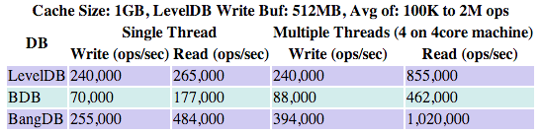
Principles of Berkeley DB
ACID
Performance
Querying
Limitations
http://highscalability.com/blog/2012/11/29/performance-data-for-leveldb-berkley-db-and-bangdb-for-rando.html
Notes:
ACID: Configured in the application (See transaction config

Slide 9
Principles of Berkeley DB
ACID
Atomicity
Consistency
Integrity
Durability
Notes:
According to oracle, completely ACID compliant.
Consistency guaranteed, unless database configured to disable
Durability is configured in the application

Slide 10
Principles of Berkeley DB
Querying
Key-Data
No SQL
Notes:
Explain in demo

Slide 11
Principles of Berkeley DB
Limitations
Database Size depends on page size
Page size is chosen by application
Page sizes are saved as unsigned 16-bit numbers
Minimum page size: 512 bytes
Maximum page size: 65.536 bytes
Minimum-maximum database file size: 2^41 (2 terabytes)
Maximum database file size: 2^48 (256 terabytes)
Largest key/data item is 2^32
Maximum Btree depth: 255

Slide 12

Economics
Famous Case
Market Share
Notes:
Amazon
Bitcoin Core, until Bitcoin Core 0.8, changed to LevelDB
Previously Subversion

Slide 13
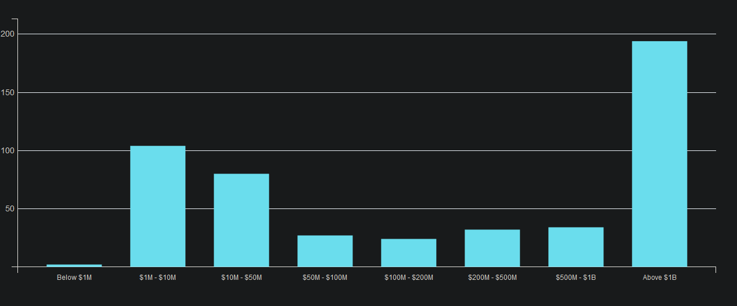
Economics
88th - https://db-engines.com/en/ranking
first released in 1994
1996 – 2006 Sleepycat Software
Acquired in 2006 by Oracle
Oracle Berkeley DB
Berkeley DB Java Edition
Berkeley DB XML.
https://discovery.hgdata.com/product/oracle-berkeley-db

Slide 14
Demo

